Slide 1
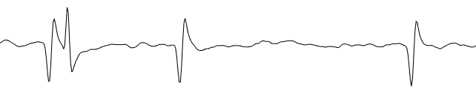
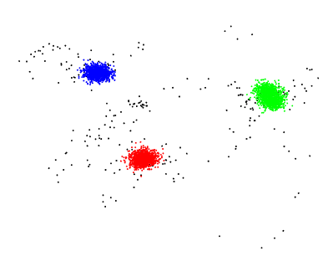
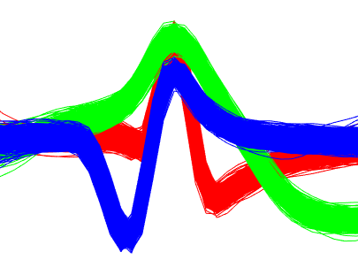
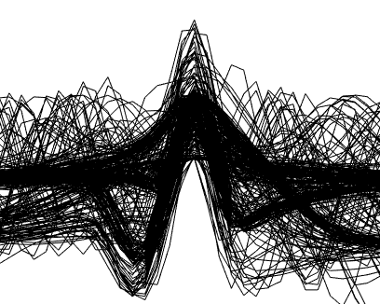


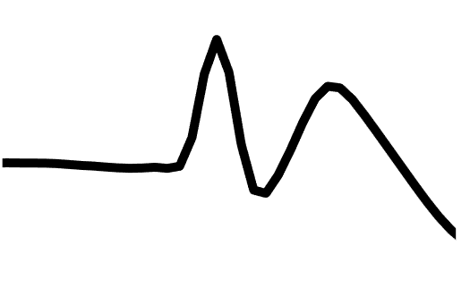
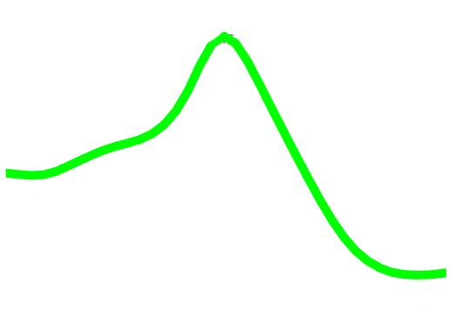
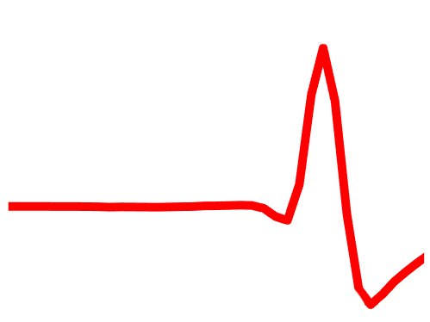
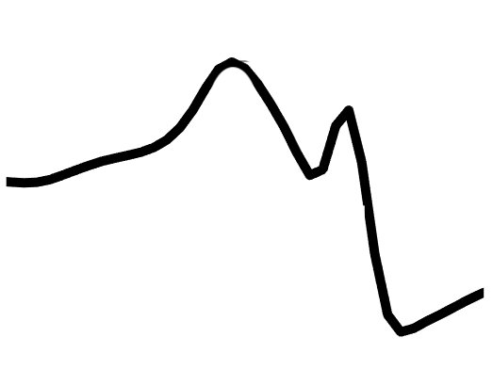
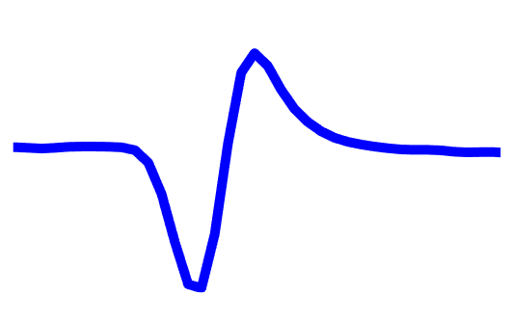
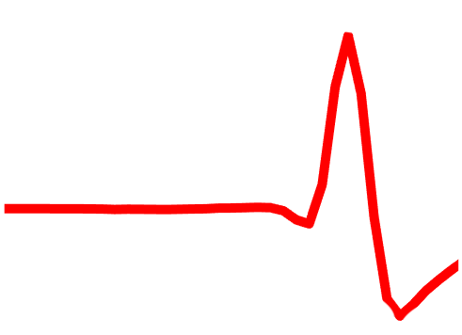
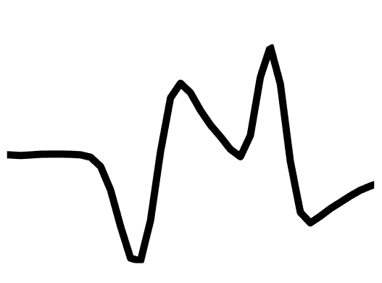
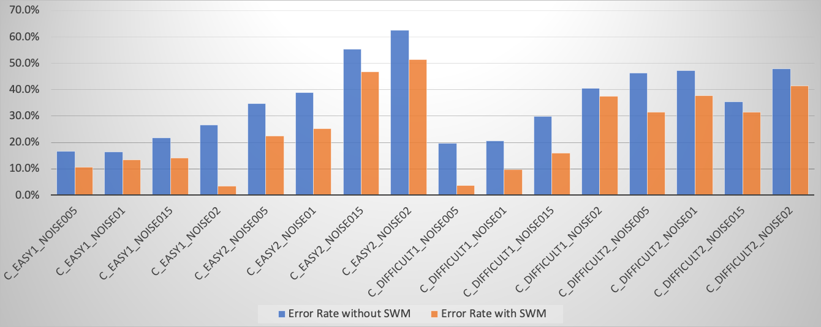
Classification of Overlapping Action Potentials Using Synthetic Waveform Matching
Srdjan Sumarac
Supervisors: James Saunderson, Yan Wong
Simulated data taken from the SYNTH MONOTRODE study on SpikeForest
Project Aim
Spike sorting is the process of grouping action potentials in electrophysiological data.
By exploring various machine learning and signal processing techniques, the aim of this project was to design an algorithm to reduce spike sorter classification errors associated with overlapping spikes.
Overlapping Spikes
Isolated Spike
The Problem
Standard clustering approaches classify well-isolated spikes accurately. However, when multiple neurons within the same vicinity fire action potentials simultaneously, the detected waveforms corrupt the low-dimensional feature space and greatly hinder spike sorting accuracy. Addressing these collided spikes requires further action.
Synthetic Waveform Matching
Synthetic waveforms are generated via superposition using pair-wise combinations of each template at all possible time shifts from each other. Subsequently, overlapping waveforms were matched using a weighted absolute difference as a similarity metric and assigned to their respective synthetic template label, and then automatically translated to the equivalent single-unit combination
Results
The SWM Module was evaluated against the ”Ground Truth” in terms of false positive rates. On average, SWM reduces false positive error rates for collided spikes by over 10%!

